Slide 1


DataBase Logic in Business Applications
Al.I. Cuza University of Iași
Faculty of Economics and Business Administration
Department of Accounting, Information Systems
and Statistics
Model Seeds and Patterns in Database Modeling (1)
By Marin Fotache & Co.

Slide 2
Notice
All the Oracle Data Modeler diagrams in this presentation are archived and can be downloaded at:
https://github.com/marinfotache/Database-Logic-in-Business-Applications/tree/master/05_Patterns%20in%20DB%20Logical%20Design
Please follow the instructions in `readme.md` file

Slide 3
What is a Data Model Pattern?
A template (no matter the size) with a certain degree of generality, which can be applied to many (real world) cases
A template of interacting objects, one that may be used again and again by analogy (Coad, 1995)
An idea that has been useful in one practical context and will probably be useful in others (Fowler, 1997)
A design pattern systematically names, motivates, and explains a general design that addresses a recurring design problem... It describes the problem, the solution, when to apply the solution, and its consequences (Gamma et al., 1995)
A pattern is a recurring solution to a standard problem... Patterns have a context in which they apply (Schmidt, 1996)
A model fragment that is profound and recurring (Blaha, 2010)

Slide 4
What is a Data Model Pattern? (cont.)
Muller, 1999:
DMP store solutions developed and refined by modelerd through their experience
Tradition
Is reusable, describing a design problem and its solution
Problem-solution pair in a given context. A pattern does not only document ‘how’ a solution solves a problem but also ‘why’ it is solved (Zdun, 2005)
Pattern elements (Gamma et. Al, 1995):
Name
Problem description (the set circumstances defining the problem and identifying it from other problems)
Description of solution
Presentation of pattern’s ingredients, logic, strengths and weaknesses

Slide 5
Data Model Pattern Benefits
Enriched modeling language – modelers don't need to think only in terms of primitives, but also in terms of frequent combinations. Patterns are prototypical model fragments that distill the knowledge of experts.
Improved documentation. Patterns offer standard forms that improve modeling uniformity.
Reduce modeling difficulty by identifying common problems and present alternative solutions along with their trade-offs.
Faster modeling. With patterns developers do not have to create everything from scratch. Developers can build on the accomplishments of others.
Better models. Patterns reduce mistakes and rework. Each pattern has been carefully considered and has already been applied to problems, so ir is more likely to be correct and robust than an untested, custom solution.
Reuse. Patterns provide a means for capturing and transmitting development insights so that they can be improved on and used again.
Source: Blaha, 2010, pp.3-4

Slide 6
Data Model Pattern Drawbacks
Sporadic coverage. A good model is not just a sum of some patterns
Pattern discovery. It can be difficult to find a pertinent pattern, especially if the idea in your mind is ill-formed
Complexity. Patterns are an advanced topic and can be difficult to fully understand.
Inconsistencies. There has been a real effort in the literature to cross reference other work and build on it. However, inconsistencies still happen.
Immature technology. The patterns literature is active but the field is still evolving.
Source: Blaha, 2010, p.4

Slide 7
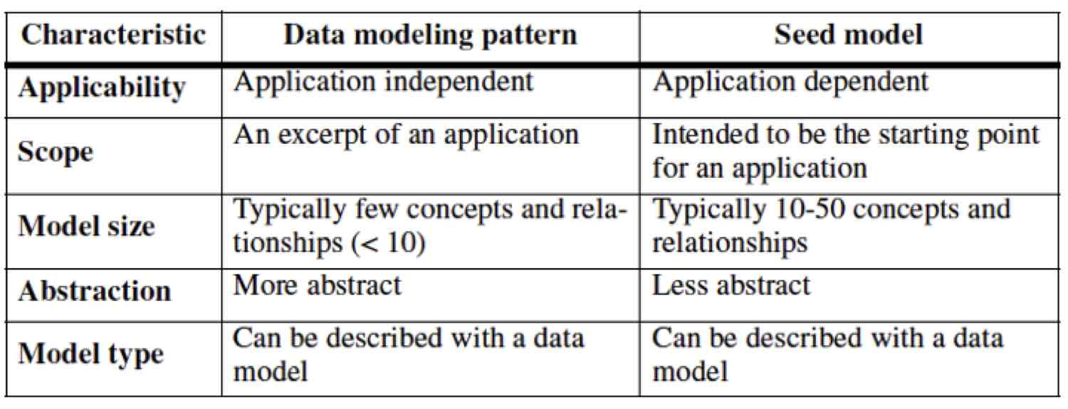
Patterns vs. Seed Models
A pattern is abstract and stands apart from any particular application
A seed model is a model that is specific to a problem domain. A seed model provides a starting point for applications from its problem domain
Source: Blaha, 2010, p.5

Slide 8
Patterns vs. Seed Models (cont.)
Here we will not be very anxious about the patterns-seed models confusion
Seeds model are not so general, but can be easily applied. Classic books on seed models:
David Hay - Data Model Patterns. Conventions of Thought, Dorset House Publishing, New York, 1996
David Hay - Data Model Patterns. A Metadata Map, Morgan Kaufmann Publ, 2006
Len Silverston - The Data Model Resource Book, Wiley, 2008
Patterns are more abstract,/general, but also more difficult to apply. Classic books:
Robert Muller – Database Design for Smarties. Using UML for Data Modeling, Morgan Kaufmann Publ, San Francisco, 1999
Len Silverston and Paul Agnew - The Data Model Resource Book, vol. 3, Wiley, 2008
Michael Blaha – Patterns of Data Modeling, CRC Press, 2010

Slide 9
Our Approach
We'll refer as Data Modeling Patterns both patterns and seed models
Examples and case-studies are based not only on previously mentioned references, but also on our experience as database modelers/developers
Gradually presented (from simple to more elaborate patterns)
E-R Barker (Oracle Case) notation
Diagrams are drawn with Oracle Data Modeler
By forward engineering, relational schema are yielded in ODM
You'll try to apply as many patterns as possible in your project schema (project - part 1)

Slide 10
Presented Seed Models and Patterns (part 1)
Heterogeneous items (in sales database)
Package of products and services
Metadata
Recipes (for preparing/manufacturing products)
Identifiable and non-identifiable (sold) products
Standard and customized configurations
Offers, discounts and penalties

Slide 11
Heterogeneous Items To Be Sold
Classic example: A company sells two types of items:
products for which two measure units (MU) are of interest:
sell_measure_unit – the measure unit indicating the packaging of the products as it is sold (e.g. 2-liter pet, 700-ml bottle, 250-grams bag, etc.)
measure_unit_qpsu – the measure unit indicating the quantity of the basic ingredient in the product sold;
Example: Product sold: 2 liter Coca-cola pet
Item name: 2 liter Coca-cola pet
sell_measure_unit: pet
prod_quant_in_sold_unit: 2
measure_unit_qpsu: liter

Slide 12
Heterogeneous Items To Be Sold(cont.)
services – that are of two types:
With unique price
With variable price that is computed multiplying a calculation_base by price_per_base_unit
Both products and services belong to groups of items
Item groups can be hierarchically structured
This seed model can be extended to other cases:
Travel agencies that offer:
Room reservations
Hollidays (e.g. seaside) in a resort
Trips (visiting historical places)
Facilities (conference rooms, spa, etc.)
Cable companies that can sell:
TV channel access
internet access
mobile phone access

Slide 13
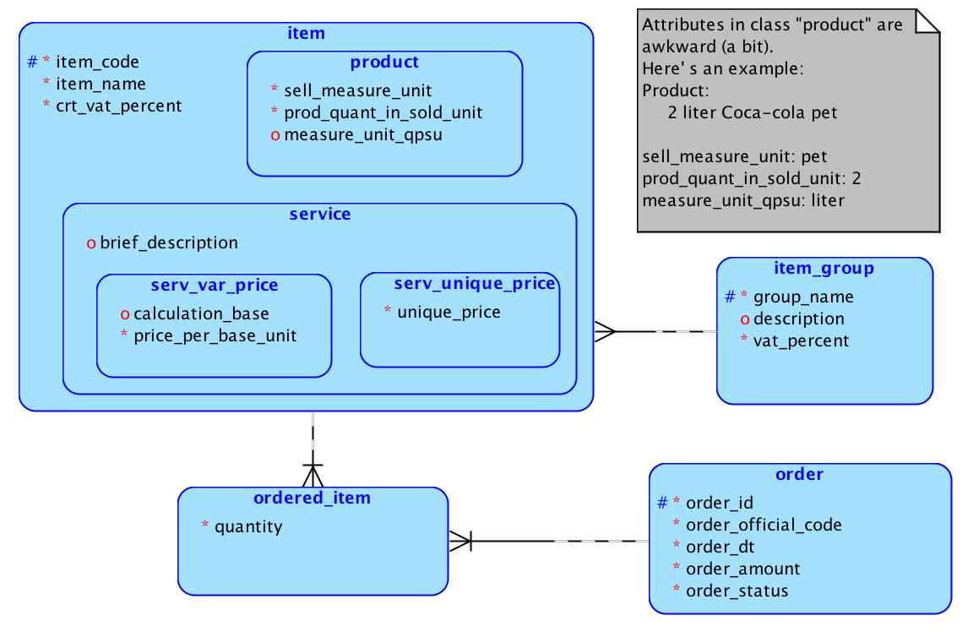
01a – heterogeneous items – v_1 (E-R)

Slide 14
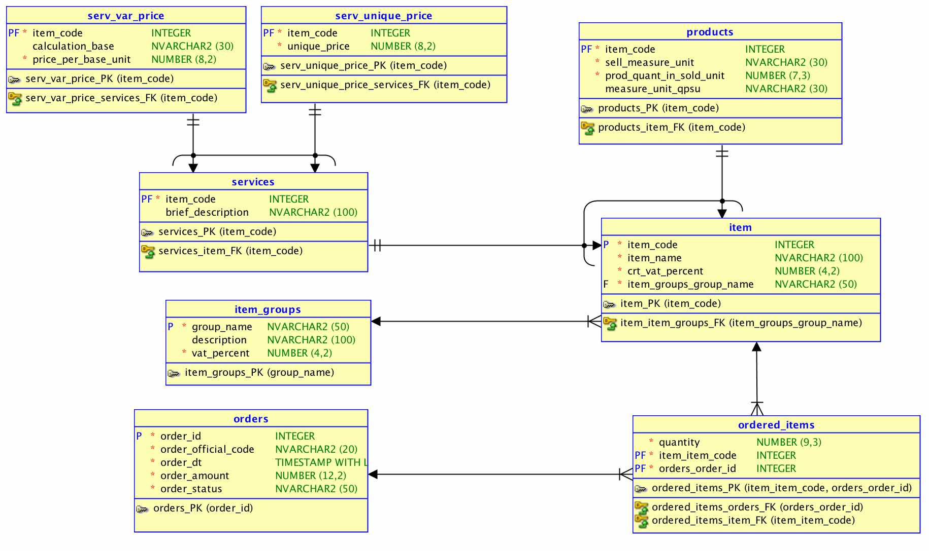
01a – heterogeneous items – v_1 (Rel.)

Slide 15
heterogeneous items – v_2
Alternative to heterogeneous Items – v_1
Removed:
Entity item
Modified:
Entities product and service are now separated
code, name and current_vat_percent properties (attributes) are copied in both product and service entities
Both entities product and service are connected to entity item_group
New:
An arc connects ordered_item (on one side) with both product and service (on the other side). The arc signals an exclusive relationship group
The item hierarchy is replaced by exclusive relationship group product-service

Slide 16
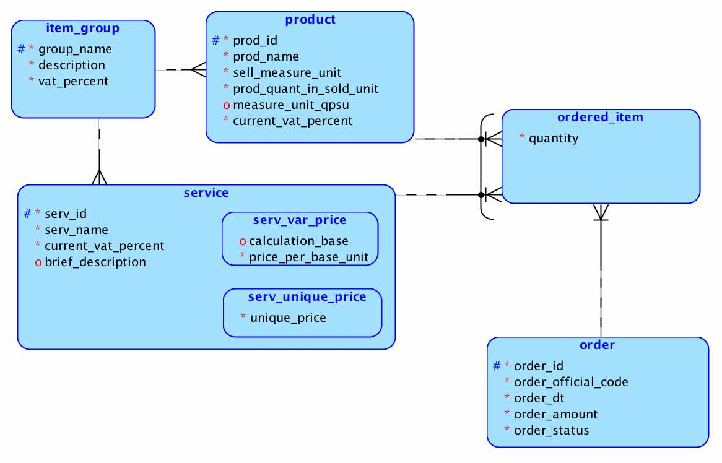
01b – heterogeneous items – v_2 (E-R)

Slide 17
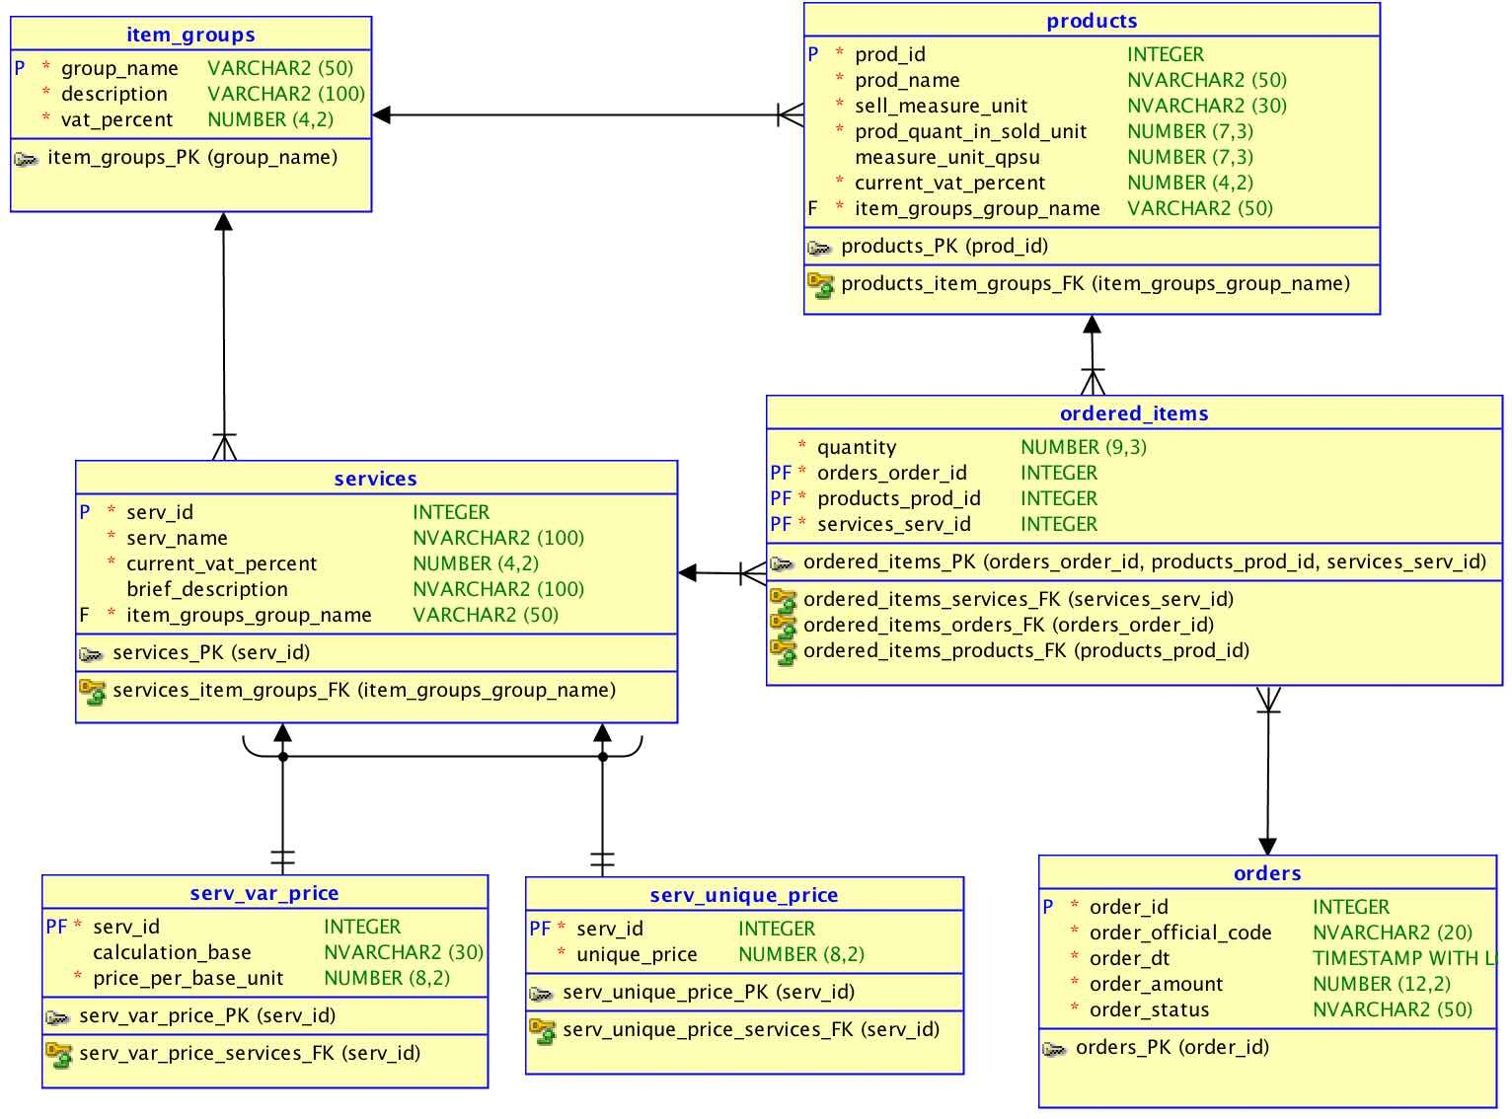
01b – heterogeneous items – v_2 (Rel.)

Slide 18
heterogeneous items – v_3
Fix the identifier (primary key) problem for ordered_item
Removed:
Identifying relationship between order and ordered_item
Identifying relationship between product and ordered_item
Identifying relationship between service and ordered_item
New:
Identifier Id for entity ordered_item (now entity class ordered_item is strong)

Slide 19
01c – heterogeneous items – v_3 (E-R)

Slide 20
01c – heterogeneous items – v_3 (Rel.)

Slide 21
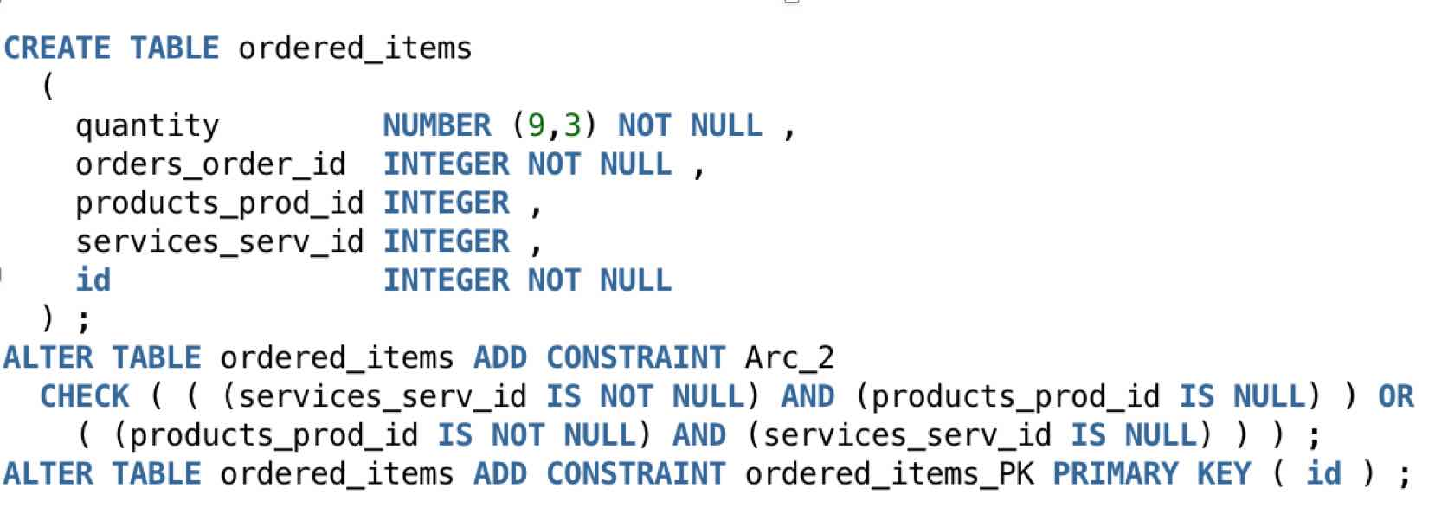
01c – heterogeneous items – v_3 (DDL for ordered_items)

Slide 22
Package of Items
Applies to any situation when an item is sold both individually or it is included in a package of items (the price refers to the whole package)
Example:
A container of six 2-liter pets of Pepsi is a package
A 2-liter pet of Pepsi is a product
New entities (to heterogeneous items – v_2):
package - general data about package (code, name, price) – as they appear in the catalog
package_composition - the products included in every package
measure_unit – general information about measurement units
equiv_measure_units – for conversion among mesurement units (e.g. 1l = 1000 ml, 1 inch = 2.53 cm, etc.)

Slide 23
Package of Items (cont).
New relationships (to heterogeneous Items – v_2):
is_meas_unit_of_sold_prod connects entities product and measure_unit. It replaces the attribute sell_measure_unit in entity product (gather the measurement unit indicating the packaging of the products as it is sold (e.g. 2 liter pet, 700 ml bottle, 250g bag, etc.))
is_meas_unit_of_qsu connects entities product and measure_unit. It replaces the attribute measure_unit_qpsu in entity product (gather the measurement unit indicating the quantity of the basic ingredient in the product sold)
measure_unit_converted_from connects entities measure_unit and equiv_measure_units. Refers to the role of source measurement unit in MU conversions
measure_unit_converted_to connects entities measure_unit and equiv_measure_units. Refers to the role of destination measurement unit in MU conversions

Slide 24
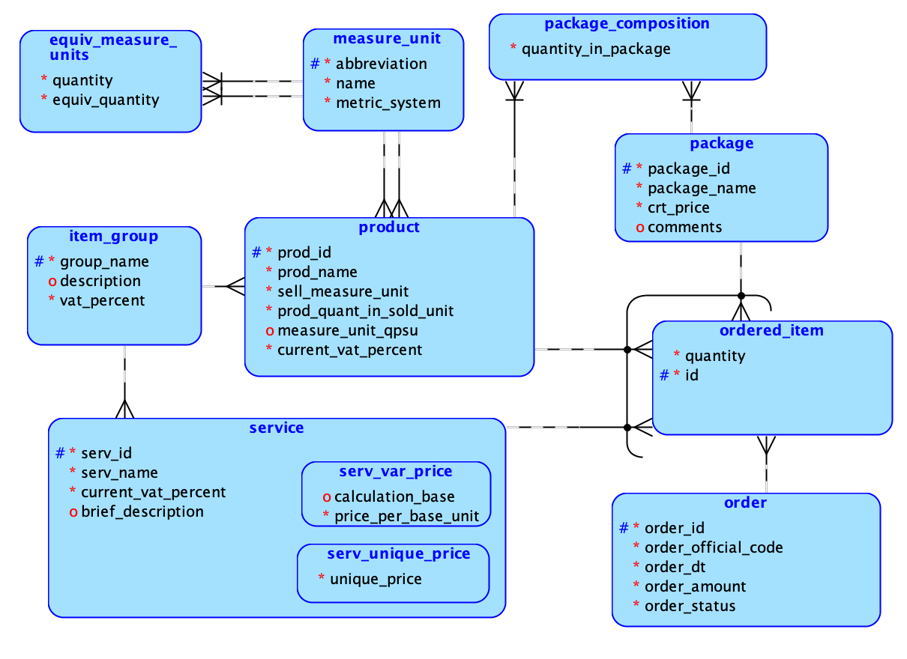
02a - package of items – v_1 – E-R

Slide 25
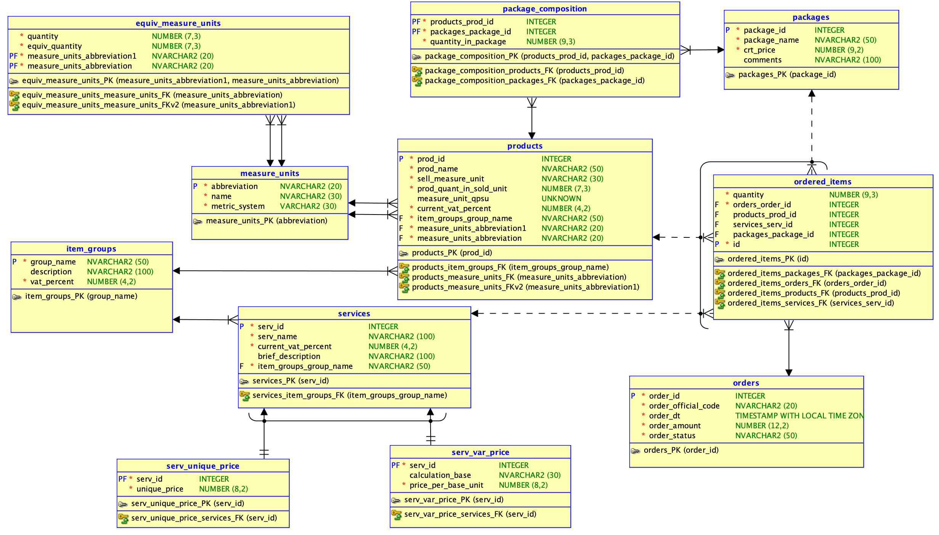
02a - Package of Items v_1 (Relational)

Slide 26
02b - Package of Items – v_2 – E-R
What's new:
A package may contain also services, e.g.
when selling product X, delivery is free
when selling product Y, assembling/mounting is free
when selling product Y, adjustements (length, height) are charged half price
A package may contain also another package. Example: A furniture supermarket sells Kitchen Smoke on the Water (which is a package) that is composed of:
Package Stove Earth, Wind and Fire composed of:
Product Stove Whirpool SW4450
Product Hood Whirpool HW44
Six pieces of product Chair Sit-Down-And-Eat
A piece of Just-A-Kitchen-Table
Package Shelves for A Kitchen composed of
Two shelves Sh1
Three shelves Sh2
A service: delivery
Another service: Furniture adjustements and mounting

Slide 27
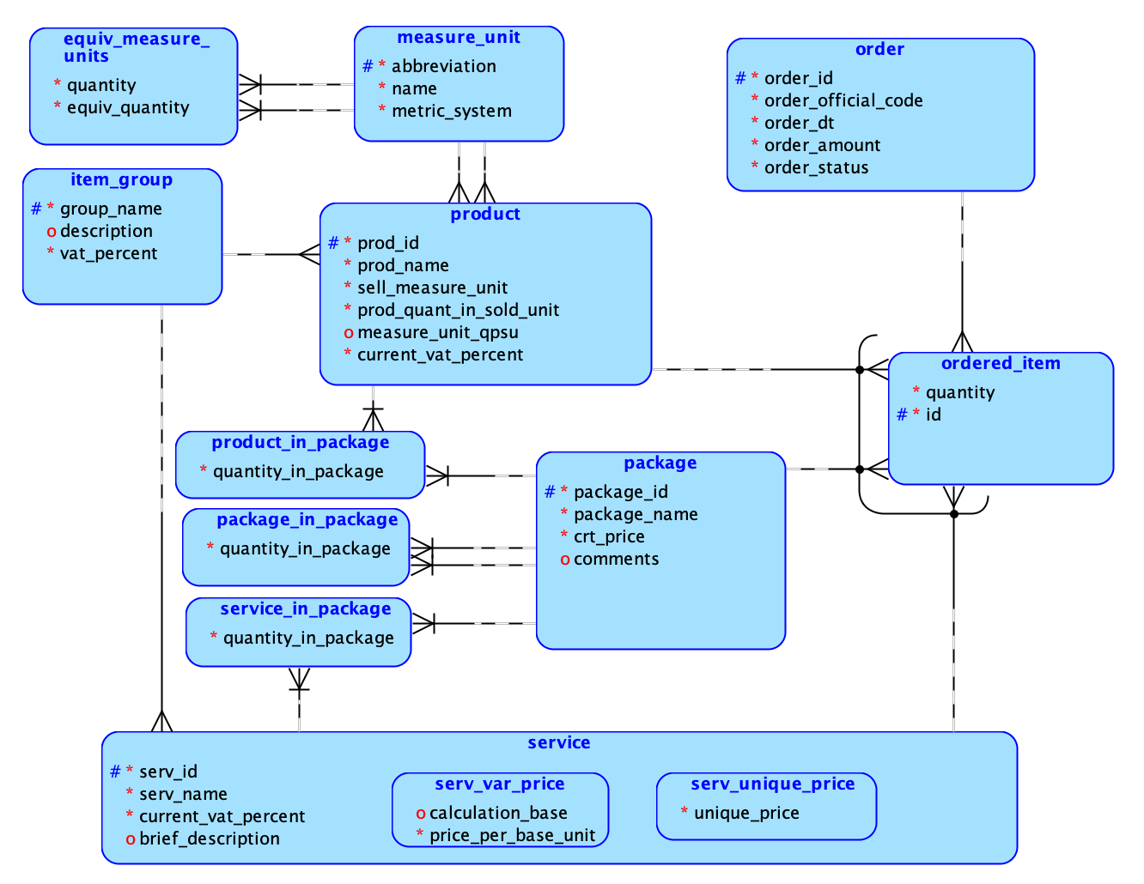
02b –Package of Items v_2 – E-R

Slide 28
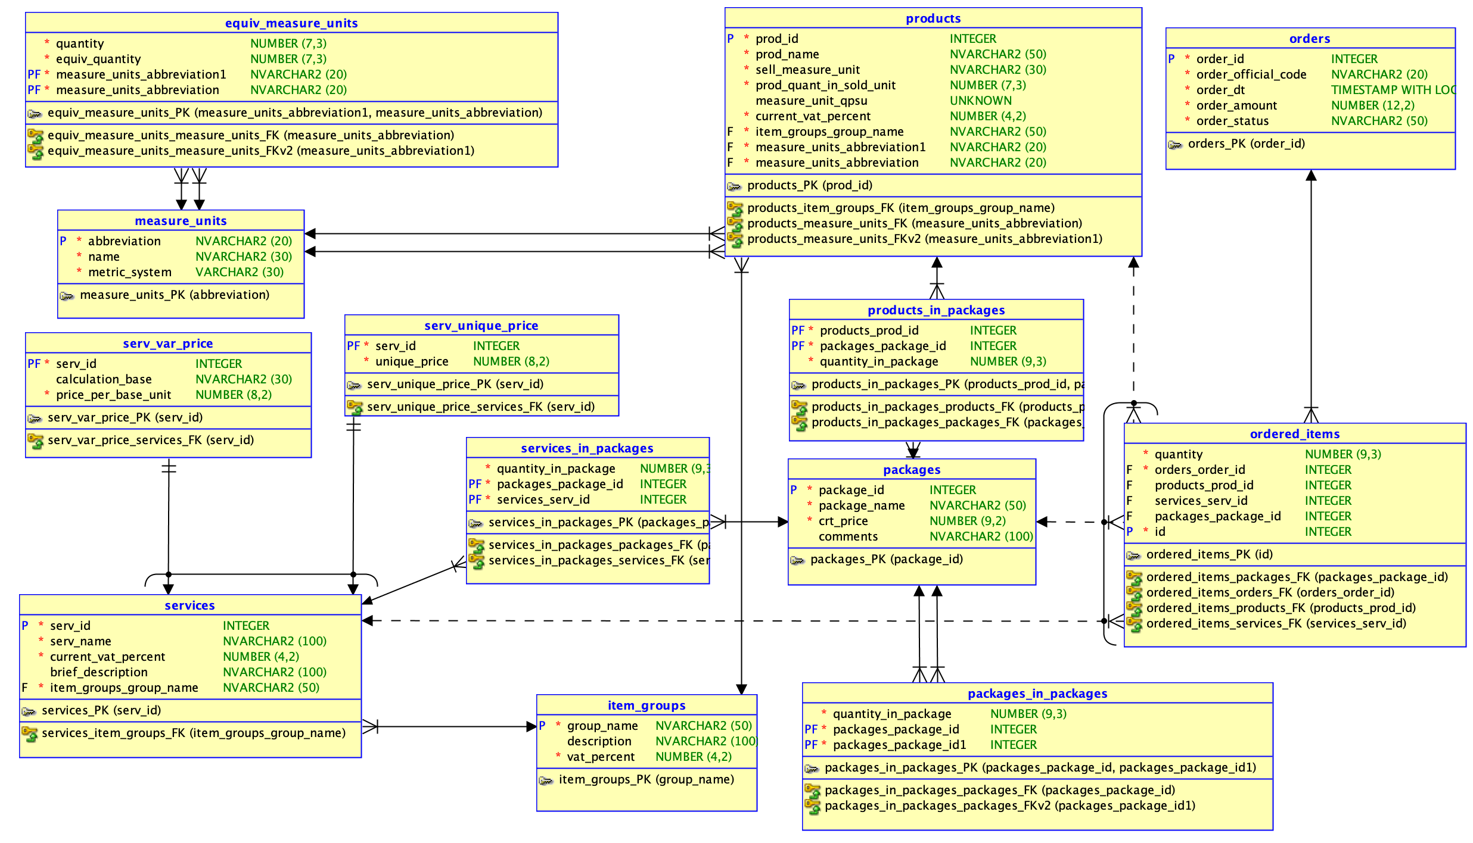
02b –Package of Items v_2 – Rel.

Slide 29
Metadata
One of the most general and versatile data model pattern
Metadata is key ingredient in database and data warehouse "philosophy"
Deal best with many and heterogeneous properties for entities
Basically it replaces tables attributes/columns with rows.
Example: an e-Commerce site sells computers, printers, DVDs, TVs, mobile phones, tablets etc.
Without metadata there are two main solutions:
A single entity – product – with hundreds of attributes/properties (such as microprocessor manufacturer, microprocessor family, microprocessor frequency, RAM class, RAM size, number of printed pages per minute, number of USB 2 ports, number of USB 3 ports, etc.) and a huge number of empty (NULL) values for each record
A "root" entity - product - containing common properties (code, name, manufacturer, group, etc.) and (at least) one sub-entity for each group of products – laptop, tablet, TV, smartphone, printer, etc. Entities corresponding to (sub) groups of products can be organized as a hierarchy

Slide 30
Metadata (cont.)
Example: e-Commerce (continued)
With metadata we basically need two entities:
One containing all the possible properties (some properties are common to many groups of products, other are specific to only a group of products) – property
Another stores the values of all properties for a given product – product_description
In E-R diagram on the next slide, both group of products and individual product can be described using metadata pattern
With entity group_description every property of the group of products is declared (and also if that property is compulsory to be declared for each product in that group)
Properties already specified for each product (with entity product_description) can be compared with the mandatory properties of that product group and see which properties are not yet declared for that product

Slide 31
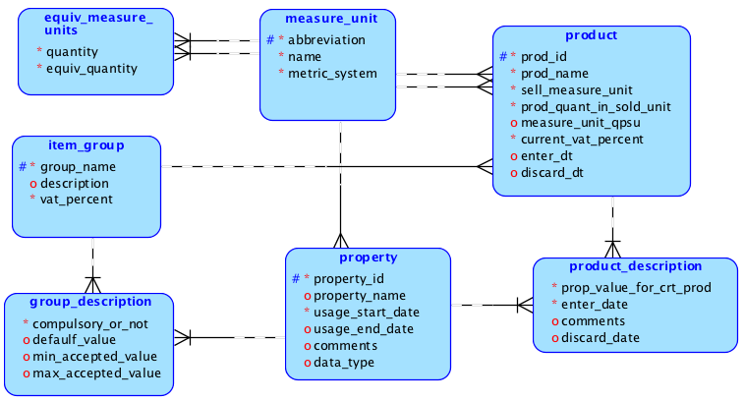
O3 - metadata – products and groups full description – E-R

Slide 32
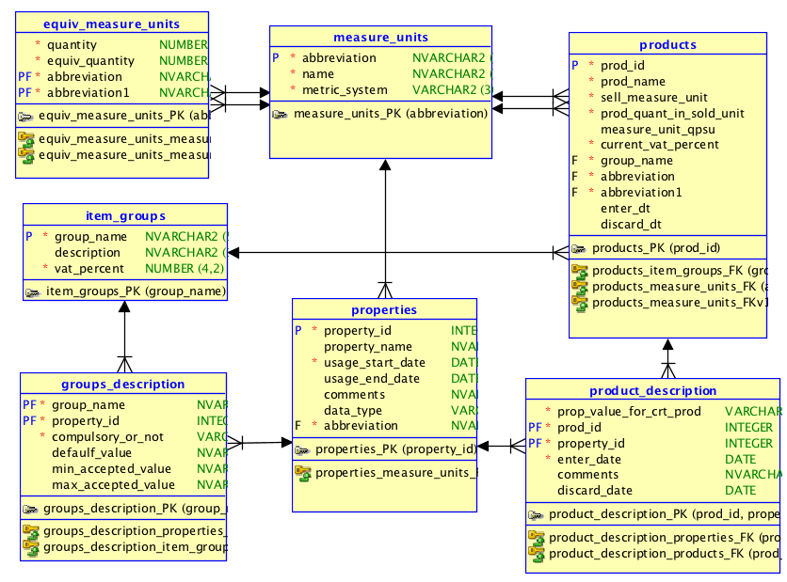
O3 - metadata – products and groups full description – Relational

Slide 33
Questions (to be discussed during lecture)
How can we model the fact that groups of products are hierarchically organized?
How can we model the fact that properties also are hierarchically organized?
See also the next presentation (the Tree pattern)

Slide 34
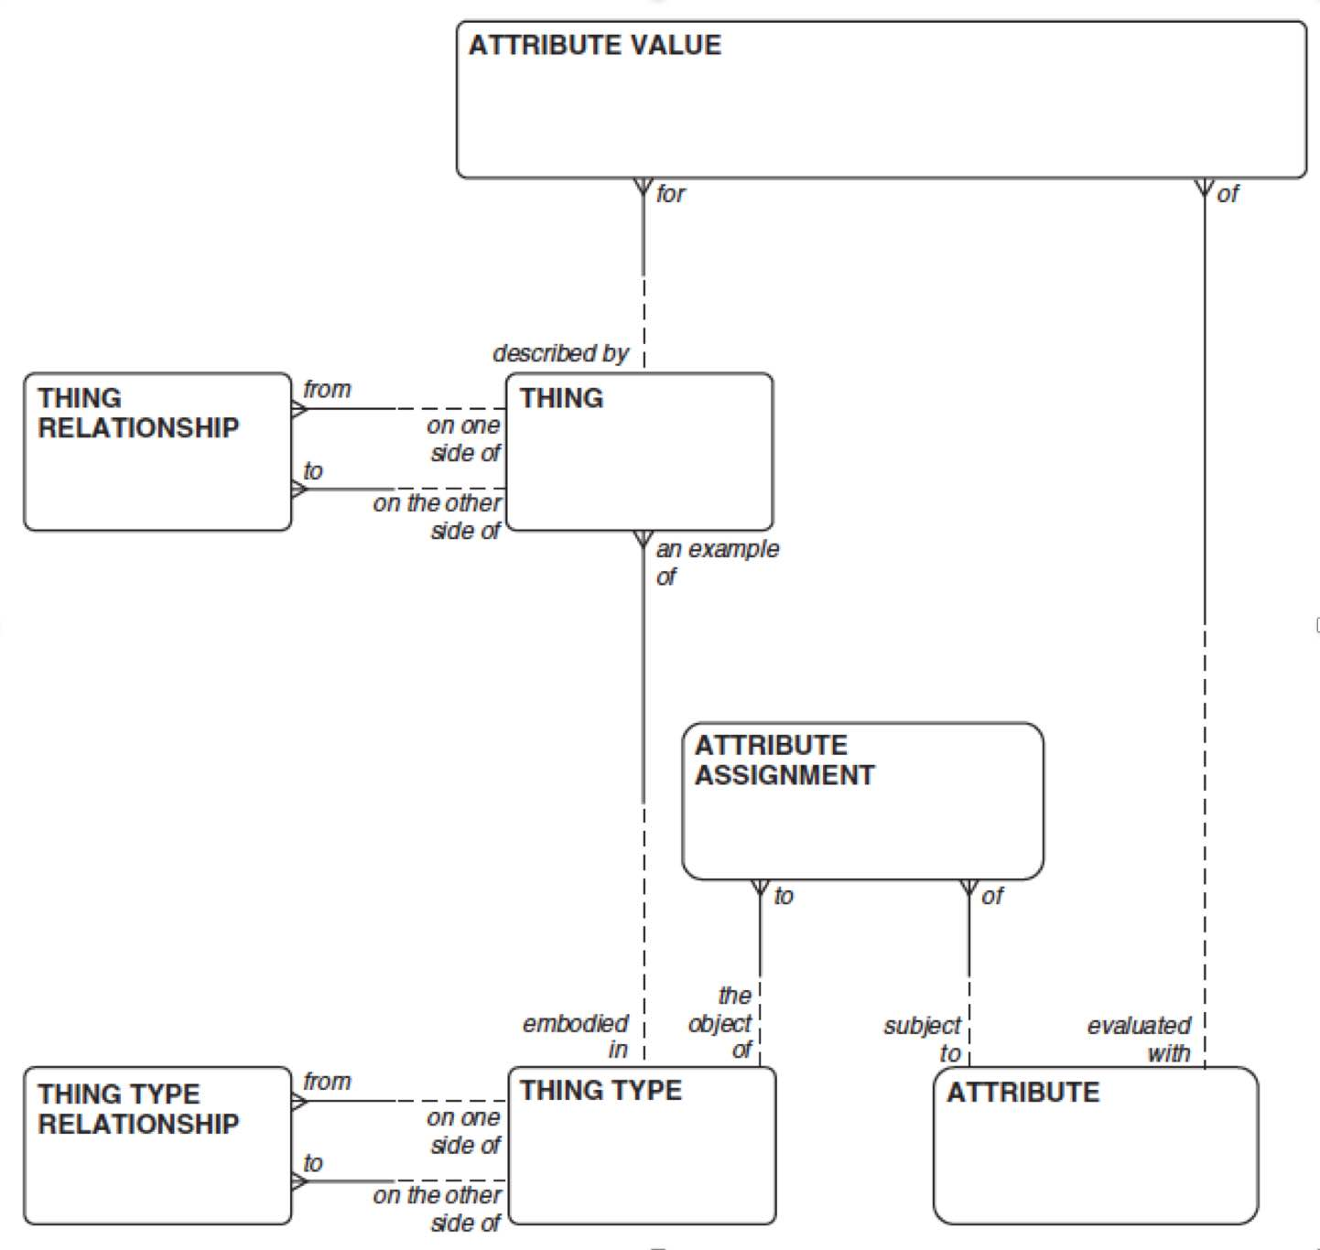
The Ultimate Metamodel
Source: Hay, 2006, p.30

Slide 35
Recipes for Assembling Products
Deals with situations when the entities can exist (or be sold) individually but also can be assembled into another product (that also exists/is sold)
Example: E-Commerce & Manufacturer: A Hard Disk Drive can be sold per se, but also may be used for manufacturing a desktop computer (or a laptop)
Two new entities: recipe which stores general information about recipes and recipe_detail describing the ingredients for preparing/assembling the product referred to by the recipe
This seed model can be adapted to any type of recipe when some ingredients may be sold separately (pizza, cocktails, ...)

Slide 36
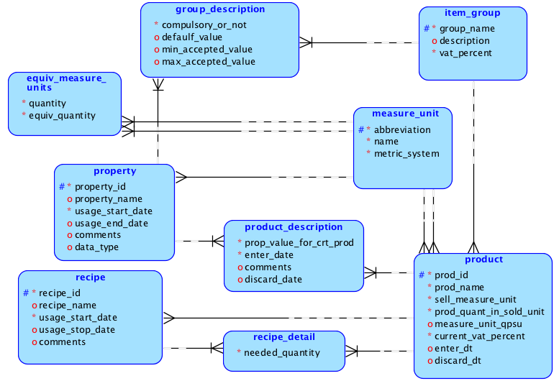
04 – recipes (E-R)

Slide 37
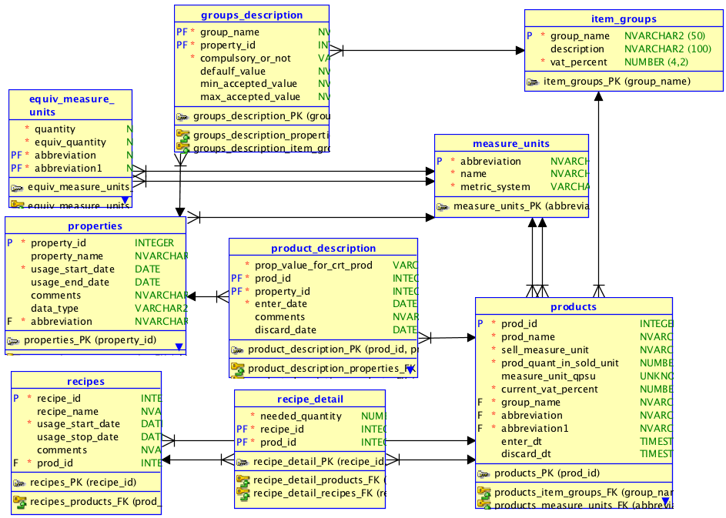
04 – recipes– Rel.

Slide 38
Products: Models and Serial Numbers
Useful when some of the products have warranty and then each product occurence must be identified with a serial number (cars, laptops, printers, smartphones)
Other products are not tracked individually (generally they do not imply warranty): cables, printer paper, DVDs etc.
For products with warranty, a product model appears in the catalog (containing the most important features of the products)
Customers order a model of such a product (having certain features)
When delivered, the product has an associated serial number that makes it identifiable (for future warranty assistance)
Two new entities: recipe which stores general information about recipes and recipe_detail describing the ingredients for preparing/assembling the product referred to by the recipe
This seed model can be adapted to any type of recipe when some ingredients may be sold separately (pizza, cocktails, ...)

Slide 39
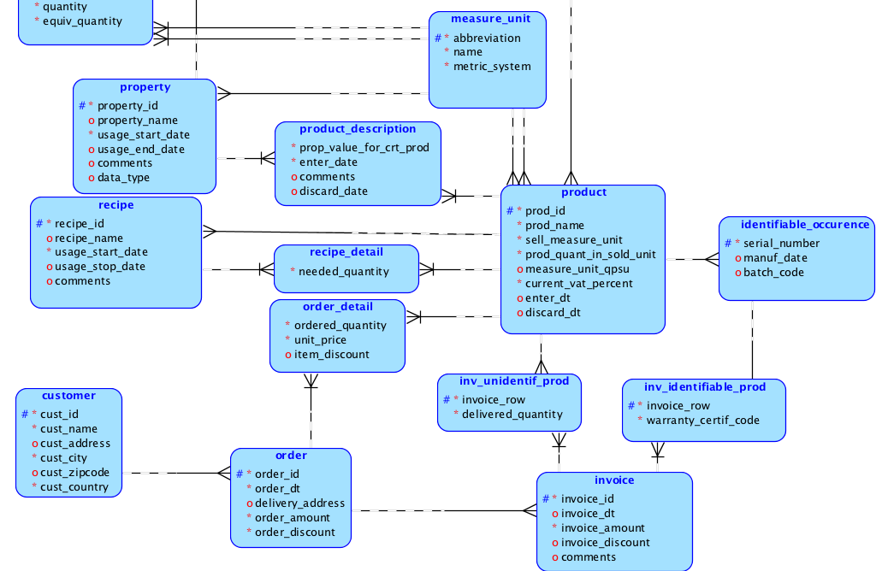
05 - models and serial numbers (E-R)

Slide 40
Default and customized configurations
Classic example: car sales
A car to be ordered/sold belongs to a model within a brand owned by a manufacturer, but also belongs to variant of equip
Each model variant refers to a type of engine and a set of default features (fog lights, rain sensor, leather-covered wheel, GPS, cruise control, leather chairs etc.)
Features can be default for some model variants and customizable (must be paid) for other variants
In some cases, a customizable feature may replace one or more default features

Slide 41
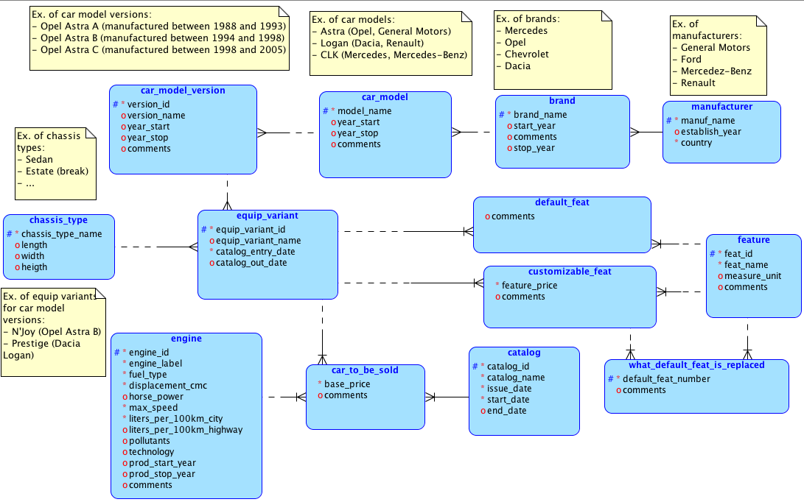
06 –configurations (E-R)

Slide 42
Offers & discounts
Companies use a large variety of offers to discounts for (hopefully) boosting the sales
07a: discounts based on invoice (order) range of values - a discount percentage is defined for every range of values; the discount amount is computed multiplying invoice amount by the discount percentage of the range corresponding to the current invoice amount
07b: each time a customer buys N1 units of product P1, N2 units of product P2 will be offered free of charge; P1 and P2 can be the same (free products can be the same with the product that is bought)
07c (generalization of 07b): each time a customer buys NPB1 units of product PB1 and NPB2 units of product PB2 and ... and NPBk units of product Pbk, then NPO1 units of product PO1 and NPO2 units of product PO2 and ... and NPOm units of product POm will be offered free of charge; PBs and POs can be the same

Slide 43
07a: Discounts based on invoice (order) range of values
07a: Discounts based on invoice (order) range of values - a discount percentage is defined for every range of values; the discount amount is computed multiplying invoice amount by the discount percentage of the range corresponding to the current invoice amount
New entities:
discount_val_range contains general information about this type of discounts; when ranges or percentages are changes, a new record is added in this entity (its corresponding table)
range_of_value – defines the ranges of values and the corresponding discount percent for each range
New attribute:
discount_on_value in entity invoice
Example:
Starting with 2016-01-01 the seller offers the following discounts:
for invoices with an amount between 1500 and 3000: 3% (of the invoice amount)
for invoices with an amount greater than 3000: 5% (of the invoice amount)
The total amount of invoice 345678 issued on 2016-01-10 is 5000 lei. For this invoice the discount amount is 5000 * 5% = 250 lei

Slide 44
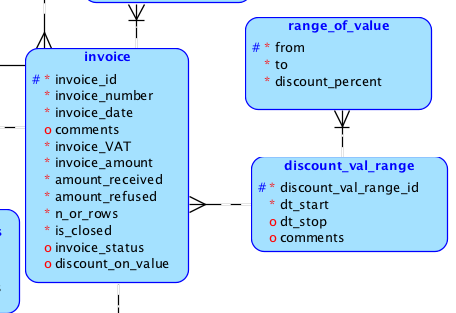
07a_discounts_on_range_of_values (E-R Diagram)

Slide 45
07b Product bought, product offered
07b: each time a customer buys N1 units of product P1, N2 units of product P2 will be offered free of charge; P1 and P2 can be the same (free products can be the same with the product that is bought)
New entities:
prod_offer contains the pair product bought – product offered and also the quantities of these two products (what is the quantity of product bought that triggers the offer and how many units of P2 are offered free of charge)
Discount replaces discount_val_range, because this time this entity contain general information of both types of discounts
New attributes:
discount_on_prods in entity invoice
row_discount in entity invoice_detail
Examples:
Starting with 2016-01-01 the seller offers two new types of discounts:
When a customer buys a notebook Lenovo XYZ a backpack Carry_Me ZZZ is offered free of charge
When a customer buys two reams (of paper) Paperback_Writer another one is offered for free

Slide 46
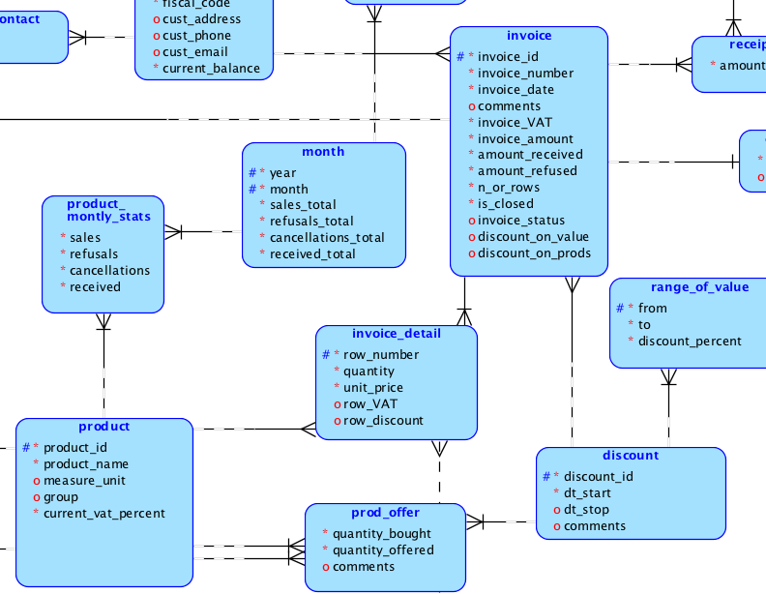
07b_product_bought_product_offered (E-R)

Slide 47
07c Products bought, products offered
Is a generalization of 07b: each time a customer buys NPB1 units of product PB1 and NPB2 units of product PB2 and ... and NPBk units of product Pbk, then NPO1 units of product PO1 and NPO2 units of product PO2 and ... and NPOm units of product POm will be offered free of charge; PBs and POs can be the same
New entities:
bought_prod_in_offer contains the condition for the discount to be applied (NPB1 units of product PB1 and NPB2 units of product PB2 and ... and NPBk units of product Pbk)
free_prod_in_offer stores the the products offered as a discount (NPO1 units of product PO1 and NPO2 units of product PO2 and ... and NPOm units of product POm )
Attributes romoved:
quantity_bought in entity prod_offer
quantity_offered in entity prod_offer

Slide 48
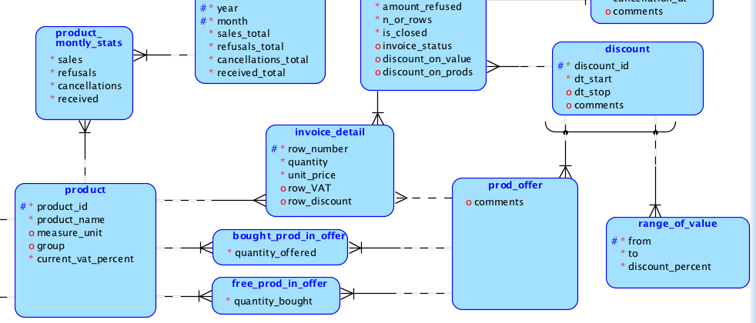
07c_products_bought_products_offered E-R Diagram

Slide 49
Other types of Offers & discounts
Offer of a company which rents DVDs/Blurays:
After five paid rented DVD/Bluray, the sixth is free
After seven paid rented DVD/Bluray, the eigth and the nighth are free
Offer of a mobile phone company:
When a customer reaches (in a month) :
n1 minutes in other national networks +
n2 SMSs
she/he gets freely:
Additional m1 minutes in national networks +
Additional m2 SMSs
Financial discounts for early payments
Discounts/offers for reaching a threshold (of sales amount, payments, number of products, a number of years since the first buy) etc.

